Slide 1
Predicting Hotel Reservation Outcomes
Team Group 8A
Sumanjali Banjara
11821870

Slide 2
Introduction
Project Purpose:
Predict booking outcomes (Completed, Cancelled, No-Show).
Identify patterns to reduce cancellations and protect revenue.
My Contribution:
Led data cleaning to prepare accurate, consistent datasets.
Designed and implemented feature engineering for better model inputs.

Slide 3
Business Problem
Goal:
identify key reasons influencing booking behavior to improve the hotel reservation system
Focus:
exploring historical data to uncover patterns in completed, cancelled and no-show bookings.
Approach :
Analyze booking patterns to optimize promotions and reduced cancellations
Outcome :
help management to optimize bookings and increase revenue

Slide 4
Dataset overview
Records: 200,000 synthetic hotel bookings
Variables: 25
Targets:
target_class: booking outcome
Target_value: realized revenue
Types :
Numerical: lead times, stay nights, rates
Categorical: channel, room type, market segment
Datetime: booking date

Slide 5
Data cleaning
Missing Values: Median for numeric, mode for categorical.
Outliers: IQR capping for loyalty points, rates, distances.
Dates: Converted and standardized booking/check-in dates.
Class Imbalance: SMOTE applied to balance “Completed” bookings.

Slide 6
Feature Engineering
Booking Value: Combined rooms, nights, and rates.
Rate Competitiveness: Hotel vs. competitor pricing.
Lead Time Buckets: Grouped for cancellation patterns.
Loyalty Tiers: Segmented engagement levels.
Derived Features: Total guests, weekend flag, seasonal indicators.

Slide 7
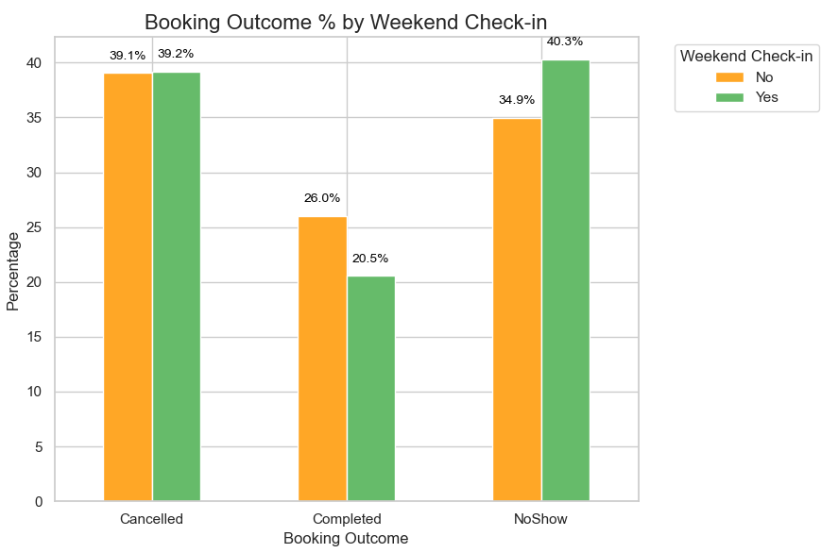
Exploratory Data Analysis
Graph: Booking Outcome % by Weekend Check-in
Key Insight:
Weekend bookings show higher no-show rates (40.3%) than weekdays.
Completed bookings drop to 20.5% on weekends compared to 26% on weekdays.
Cancellation rates remain nearly the same, indicating the main issue is attendance.
Why It Matters:
Highlights that leisure-driven weekend stays are less reliable.
Provides actionable insight to implement targeted reminders, flexible pricing, or deposits for weekend reservations.

Slide 8
Model Selection and Performance
Logistic Regression: Baseline, interpretable.
Random Forest: Captured non-linear patterns.
LightGBM: Fast gradient boosting.
XGBoost: Handled complex relationships.
CatBoost: Strong with categorical data.

Slide 9
Approach for model selection
Balanced classes using SMOTE.
Used stratified train/test split to keep class ratios.
Chose macro F1-score as the main evaluation metric.
Compared multiple models to find the most balanced performer.

Slide 10
Hyperparameter tuning
Goal: Improve model performance and class balance.
Approach:
  Used RandomizedSearchCV with stratified cross-validation.
  Optimized for macro F1-score to handle imbalance.
Tuned Models:
Logistic Regression: Adjusted regularization strength and penalty types.
CatBoost: Tuned tree depth, learning rate, iterations, and regularization.
Outcome: Tuning boosted recall on “Completed” bookings and confirmed CatBoost (Tuned) as the best model.

Slide 11
Model performance
Model | Accuracy | F1 (Macro) | Precision (Macro) | Recall (Macro) | Notes
CatBoost (Tuned) | 0.420 | 0.389 | 0.397 | 0.392 | Best macro F1; balanced predictions across classes.
Logistic Regression | 0.389 | 0.383 | 0.386 | 0.386 | Baseline model; simple and interpretable.
Logistic Regression (Tuned) | 0.389 | 0.383 | 0.386 | 0.386 | Minor tuning; no significant improvement.
CatBoost | 0.422 | 0.369 | 0.395 | 0.382 | Good with categorical data; slightly lower F1.
XGBoost | 0.423 | 0.365 | 0.396 | 0.381 | Captures complex patterns; recall slightly lower.
LightGBM | 0.430 | 0.365 | 0.405 | 0.386 | Highest accuracy; weaker macro F1 balance.
Random Forest | 0.410 | 0.361 | 0.380 | 0.372 | Handles non-linear features; lower F1 overall.

Slide 12
Criteria for Model Selection
Primary Metric: Macro F1-score
  Ensured balanced performance across all booking outcomes (Completed, Cancelled, No-Show).
  Chosen due to class imbalance in the dataset.
Secondary Metrics:
  Accuracy: To gauge overall prediction correctness.
  Precision & Recall: Evaluated ability to correctly identify each class, specially Completed bookings.
  ROC AUC: Measured class separability using one-vs-rest curves.

Slide 13
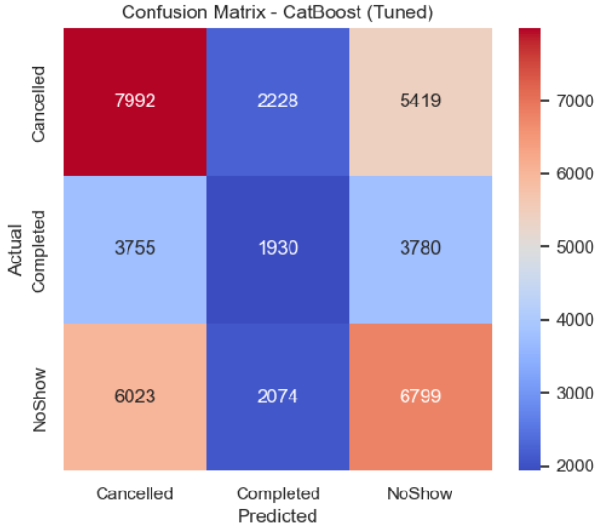
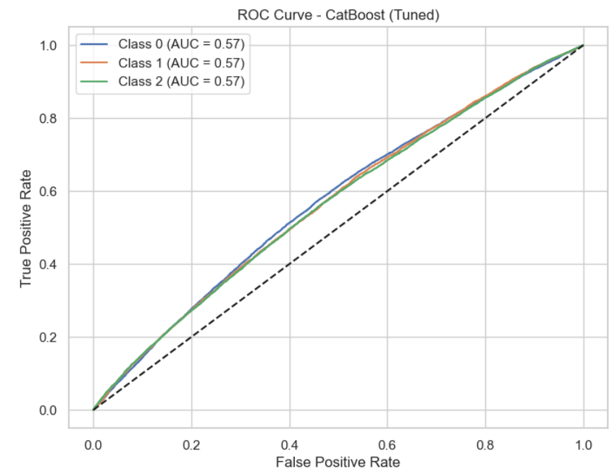
Best Model
Chosen Model: CatBoost (Tuned)
Why it Stood Out:
Achieved the highest macro F1-score among all models.
Balanced predictions across Completed, Cancelled, and NoShow.
Improved recall on the “Completed” class, crucial for revenue prediction.
Required minimal preprocessing and handled categorical features effectively.
Outcome: Selected as the final model for booking outcome prediction.

Slide 14
Applications
How it was used:
The tuned CatBoost model predicts booking outcomes (Completed, Cancelled, No-Show) using features like lead time, loyalty points, discounts, and stay details.
Expected Error:
Current accuracy: ~41.8%, macro F1: ~0.39.
On new data, anticipate similar error rates (~58% misclassifications), mainly between Completed and Cancelled.
For a CEO:
“This model acts like a forecast tool. It shows which bookings are reliable, which are at risk, and the revenue we can expect, helping us plan rooms and reduce losses.”

Slide 15
Conclusions
Lessons Learned:
Addressing missing values and outliers is key for reliable models.
Feature engineering (loyalty tiers, booking value) greatly improved insights.
Balancing data with SMOTE helped handle class imbalance effectively.
Based on the contributions of my team members, I would suggest $100,000 to each members.
Notes:
The key lessons were that clean, balanced data and meaningful feature engineering make a huge difference to predictive performance.
My contribution was leading data cleaning and creating engineered features that added business value.
For a $300,000 budget, I’d split it evenly — $100,000 each — as data prep, modeling, and analysis all played critical roles in the project."

Slide 16

Thank you

